Slide 1




Company Profile
MAGNUM WONDERPLAST (P) LTD.
WE MOULD YOUR IDEAS

Slide 2

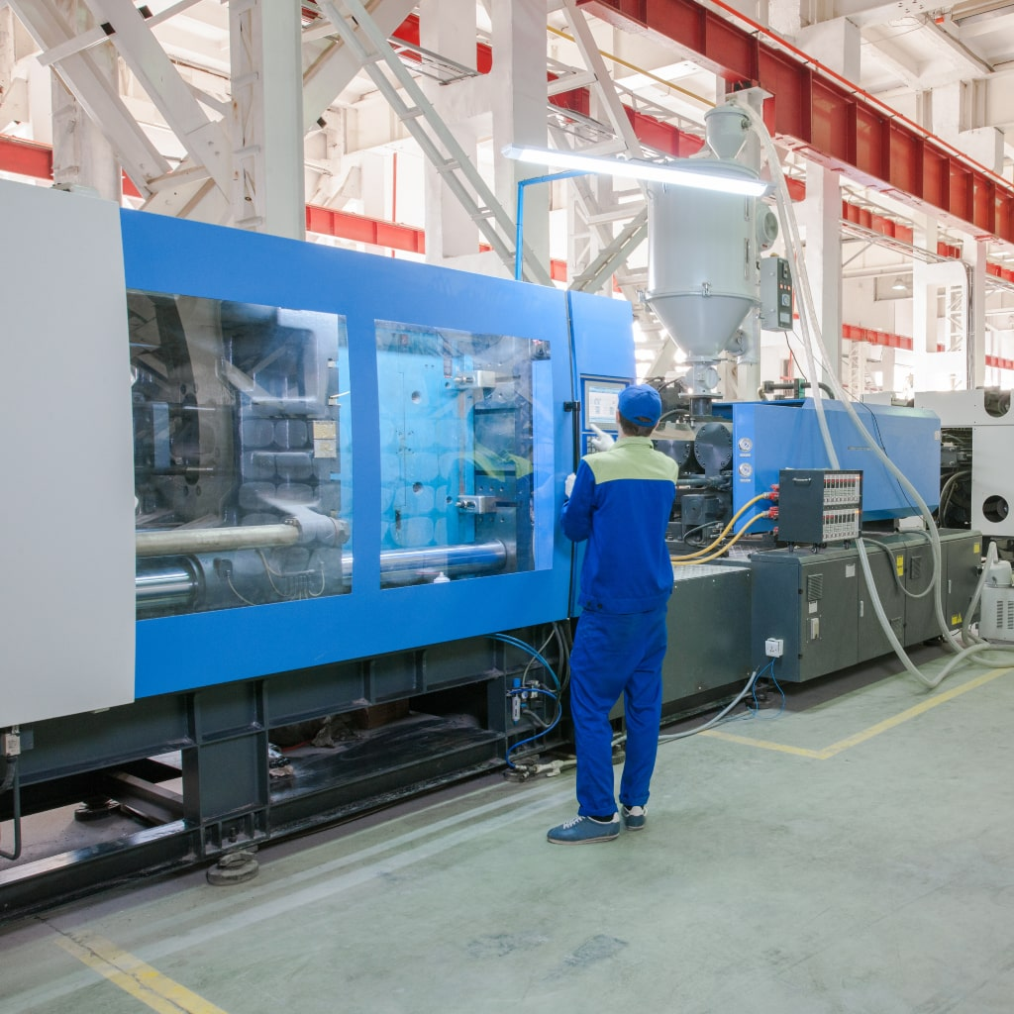
C O N T E N T
1. | Company Overview | 3
2. | Product & Technology | 4
3. | In-house Mould Design & Mould Making | 5
4. | Honors & Awards | 6

Slide 3

Introduction
Magnum Wonderplast is a leading manufacturing firm specializing in high-quality products for the automotive industry and advanced moulding solutions.
IATF – 16949:2016 | MACE GREEN |
ISO – 14001:2015 | ZED GOLD | CERITIFIED
MR. RAJIV KUMAR TREHAN
FOUNDER & MANAGING DIRECTOR
A QUAILIFIED PLASTICS TECHNOLOGIST HAVING 27 YEARS EXPERIENCE IN PLASTICS TECHNOLOGY

Slide 4
Our Mission, Vision & Goal
Mission
Serving Customers Through Continuous Innovation
To provide our customers with a full range of value-added products and services that exceed their expectations. To develop and retain dedicated, empowered employees who share in our success. To continuously improve & to achieve profitable growth over the long term using Innovative new manufacturing technologies to improve the performance and optimize the cost.
We are committed to being a trusted partner, fostering long-term relationships with our customers, and driving growth through innovation and dedication.
Goal
Top 10 Plastics Solution Provider
Our goal is to be among the top 10 automotive components and solutions providers in the industry. We are committed to delivering high-quality, innovative products that not only meet but exceed customer expectations. Through continuous improvement, we strive to enhance our manufacturing processes, ensuring efficiency and precision at every step.
By fostering a culture of excellence and engaging our skilled workforce, we aim to drive sustainable growth and solidify our position as a trusted partner in the automotive sector. Our dedication to quality, customer satisfaction, and technological advancement propels us towards achieving industry leadership and long-term success.
Vision
Excellence Through Innovative Solutions
At Magnum Wonderplast our vision is to drive innovation and excellence through our precision engineering and creative solutions. We aim to revolutionize industries by providing top-tier, customized plastic molding solutions that cater to diverse needs and challenges.
We envision expanding our reach, fostering partnerships worldwide, and creating a positive impact on the industries we serve.

Slide 5
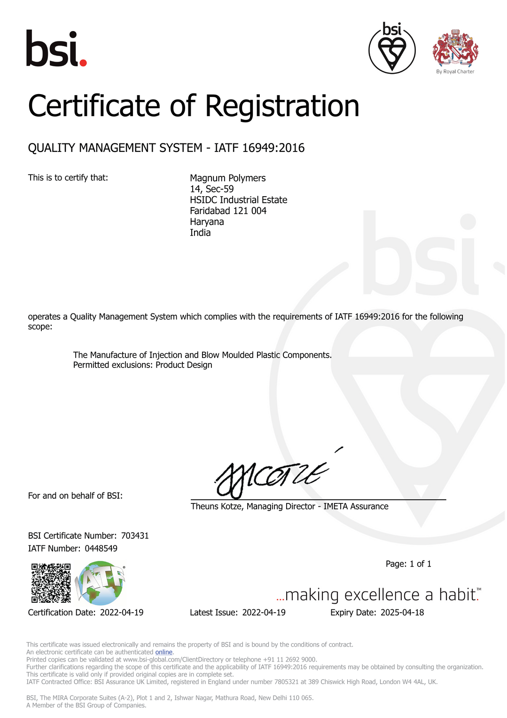
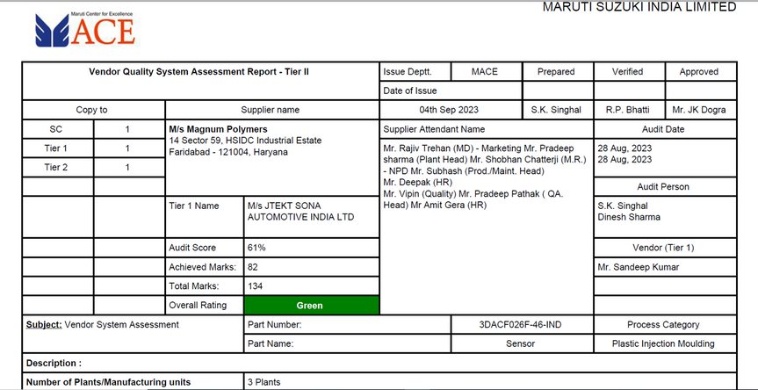


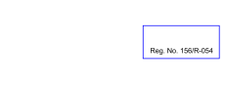

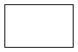


Our Accreditations:
ENVIRONMENTAL MANAGEMENT SYSTEM CERTIFICATE
Code of the certification body:
1-421-001-025
Number of the certificate:
IN01 / A0700221E
This is to certify that the Management System of
Magnum Wonderplast Pvt. Ltd.
Plot No. 14, HSIDC Industrial Estate, Sector-59, Faridabad -121004. India
is in compliance with the standard
ISO 14001:2015
This Certificate is applicable to the following activities:
THE MANUFACTURER OF PRECISION INJECTION, BLOW MOULDED &
INSERT MOULDED AUTOMOTIVE SAFETY PLASTIC PARTS &
ASSEMBLIES.
Validation of this certificate:
31/07/2025
1-421-001-025
Ing. Ján Gašper
director
MPCL 3170/31, 058 01 Poprad, Slovakia – EU
Certification is granted by:
CVI, s.r.o.,
Current issue on 31/07/2023
Expiry date 31/07/2026
System certified from 31/07/2020
subject to passing two surveillance audits during 6-12 months and 18-24 months of the certification.
For precise and up-to-date information on possible changes in the status of the certification referred to in this certificate, please phone to the number: +421 944 013365 or e-mail to the address: cvi@cvi.sk
or contact
Veritas CVI Certifications (P) Ltd.
S-31, Second Floor, Eldeco Station No.1 Mall, Sector-12, Mathura Road, Faridabad – 121007, India. Phone: +91 9810088773, 9810788773 & 9315113727 Website: www.cvi.in Email: info@cvi.in
IATF 16949:2016
MACE GREEN
ISO 14001:2015
ZED GOLD

Slide 6
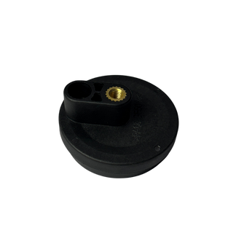
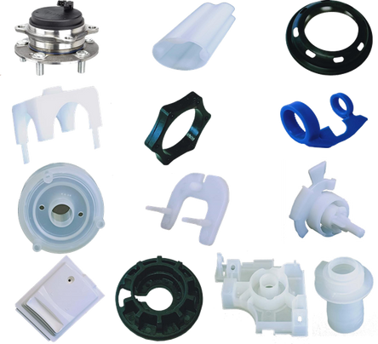
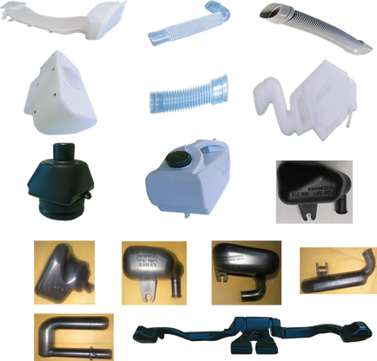
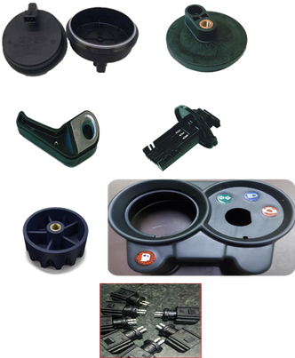
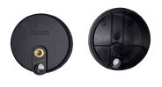
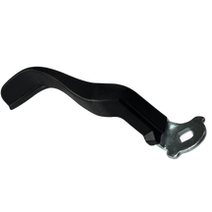
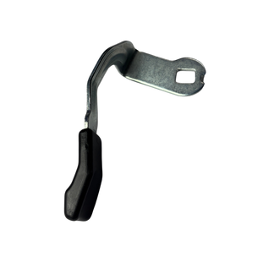
Core Products : AUTOMOTIVE
INJECTION MOULDING
BLOW MOULDING
INSERT MOULDING
Protector Oil Seal
Plastic Sleeve
CAP Strg Gear Center Marking
Basket Drain
Spacer Tilt
Half Protector Cap
Cover Steering Gear
Drain Lever Cap
Washer dryer refresher condenser
Hose
Hose Overflow
PP Tank
Tank Assembly
Resonator
Duct
Sensor Cover
Sensor Holder
Lever Assembly
Protective Cap
Body Kopa
Wiring Harness Connector
TVS Housing Speedometer

Slide 7

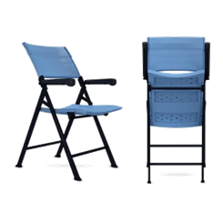
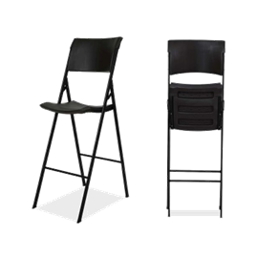
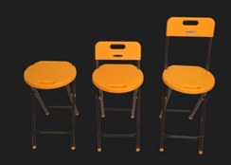
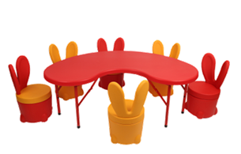
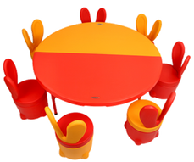
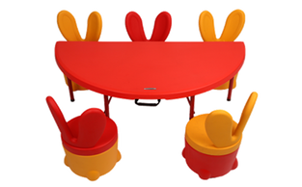
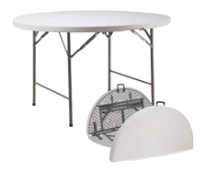
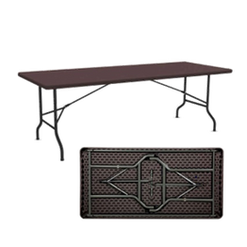
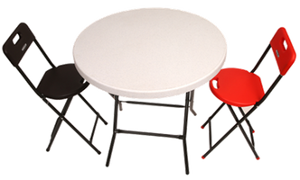
Our Brand Products :
BLOW MOULDED
CHAIRS & STOOLS
ACE STUDENT CHAIR
EEZE – CHAIR WITH ARM REST
EEZE – CHAIR
IRIS – HIGH BAR CHAIR
TEENY STOOLS
BLOW MOULDED
KIDS TABLE & STOOL
HALF MOON TABLE
FULL MOON TABLE
SMILEY TABLE
BUNNY STOOL (WITH STORAGE – 10L)
BLOW MOULDED
TABLES
BARON 4-FEET ROUND – IN – HALF TABLE
CHEERY – CAFÉ TABLE
HUGO 5-FEET RECTANGULAR TABLE
WALL MOUNTED FOLDABLE TABLE
TIFFANY BAR TABLE

Slide 8
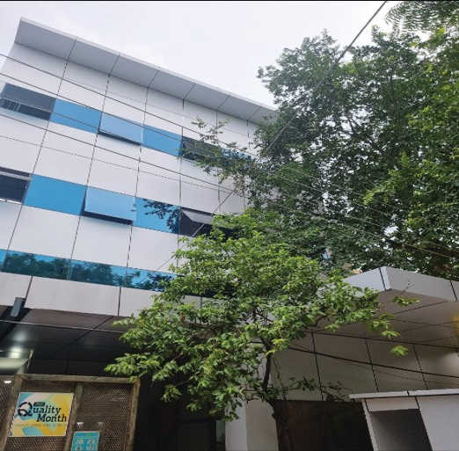
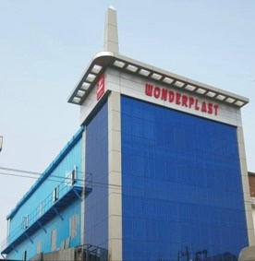
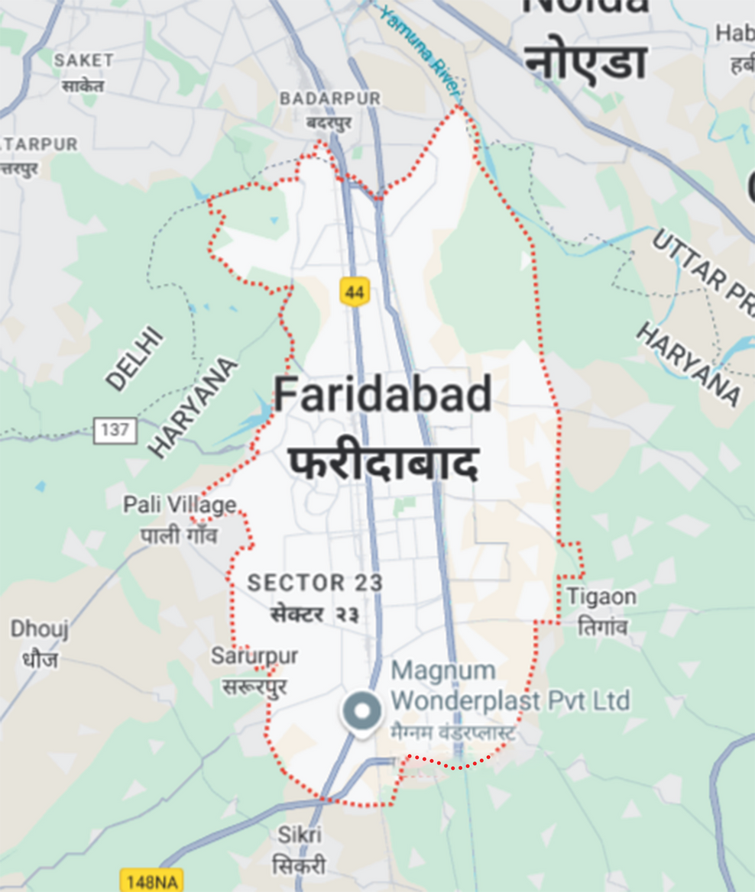
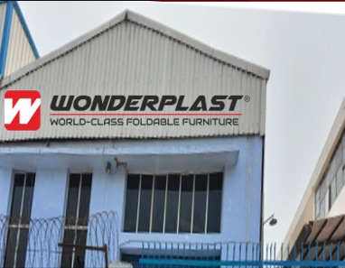
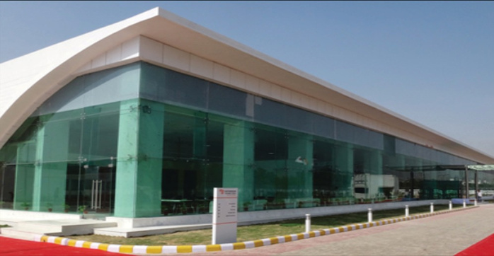

Plant Locations :
Plant 1
Plot No. 14, HSIDC Industrial Estate, Sector – 59, Faridabad Haryana (INDIA).
Plant 2
Plot No. 25. PRAGATI VIHAR Industrial Estate, Sector – 59, Faridabad Haryana (INDIA).
Scan for Location
Plant 3
Plot No. 30. PRAGATI VIHAR Industrial Estate, Sector – 59, Faridabad Haryana (INDIA).
Plant 4
Deeghot – Palwal, Haryana (INDIA), Plot Size : 6.5 Acres (Covered Area : 1 Lakhs Sq. Feet)
*Disclaimer:
Please note that the image above is for illustrative purposes only. We do not own the rights to this image, and it is used here solely to represent the conceptualization of our upcoming project.

Slide 9
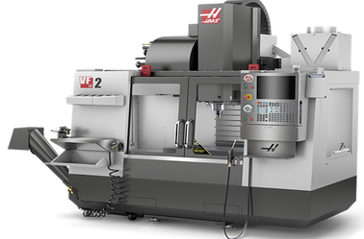
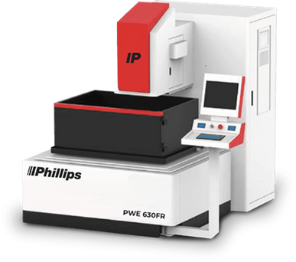
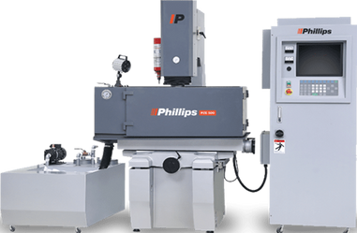
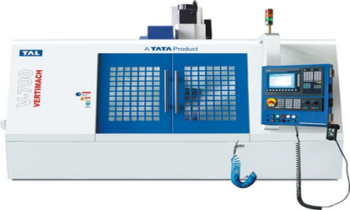
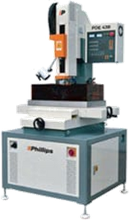
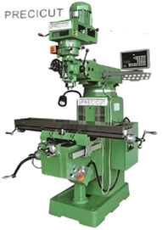
TOOL ROOM MACHINES :
S. No. | Machine Type | Capacity | Make
1 | LATHE MACHINE | 6 FEET | GD
2 | LATHE MACHINE16 | 4 FEET | GD
3 | UNIVERSAL MILLING MACHINE | 2" INCH | PRECICUT
4 | UNIVERSAL MILLING MACHINE | 2" INCH | PRECICUT
5 | DRILLING | 1/2" INCH | ITCO
6 | VERTICAL MACHINING CENTRE (VMC) | VM700 | TAL.TATA
7 | SURFACE GRINDER | 9X14" | MACHINO
8 | SURFACE GRINDER | 9X18" | GURU ARJUN
9 | SURFACE GRINDER | 9X20" | GURU ARJUN
10 | SURFACE GRINDER (AUTOMATIC) | 10X32" | KASTRUP DANMARK
11 | EDM (SPARK EROSION) | 520X30 | ELECTRONICA PSR SERIES
12 | CNC WIRECUT | 600X1050 | PHILIPS
13 | DRILL EDM | 600X400 | PHILIPS
14 | EDM | 850X590X370 | PHILIPS
15 | VERTICAL MACHINING CENTRE (VMC) * 2 NOS | VF2 | HAAS
16 | EDM (PZE 400) | 980x570x400 | PHILIPS
17 | CMM CRYSTA APEX V574 | 500 x 700 x 400 | MITUTOYO
18 | VMM (OPTIV LITE) | 500 x 400 | HEXAGON

Slide 10
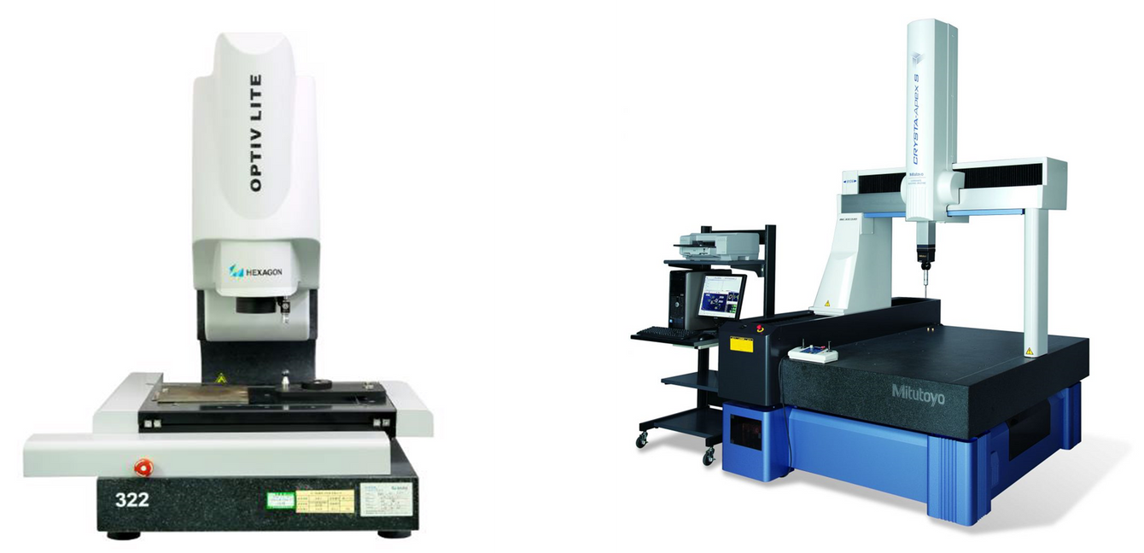
HIGH PRECISION INSPECTION FACILITIES
HEXAGON
VISION MEASURING MACHINE
MITUTOYO JAPAN
COORDINATE MEASURING MACHINE CRYSTA APEX V574

Slide 11
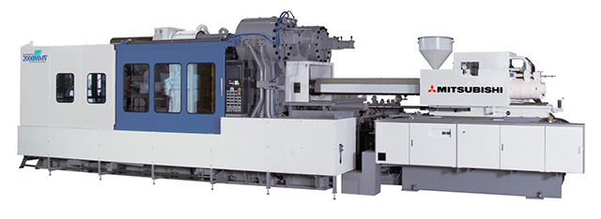
INJECTION MOULDING MACHINES :
S. No. | Machine Type | Capacity / Specification | Capacity | Make
1 | FULLY AUTOMATIC INJECTION MOULDING M/c | 35 TONNES | 1 | TOYO
2 | FULLY AUTOMATIC INJECTION MOULDING M/c | 40 TONNES | 1 | NISSEI
3 | FULLY AUTOMATIC INJECTION MOULDING M/c | 80 TONNES | 1 | BATTENFELD
4 | FULLY AUTOMATIC INJECTION MOULDING M/c | 80 TONNES | 1 | ENGEL
5 | FULLY AUTOMATIC INJECTION MOULDING M/c | 120 TONNES | 1 | NISSEI
6 | FULLY AUTOMATIC INJECTION MOULDING M/c | 150 TONNES | 1 | MITSUBISHI
7 | FULLY AUTOMATIC INJECTION MOULDING M/c | 150 TONNES | 1 | BATTENFELD
8 | FULLY AUTOMATIC INJECTION MOULDING M/c | 150 TONNES | 1 | HPM
9 | FULLY AUTOMATIC INJECTION MOULDING M/c | 180 TONNES | 1 | BATTENFELD
10 | FULLY AUTOMATIC INJECTION MOULDING M/c | 250 TONNES | 1 | HPM
11 | FULLY AUTOMATIC INJECTION MOULDING M/c | 350 TONNES | 2 | HPM
12 | FULLY AUTOMATIC INJECTION MOULDING M/c | 500 TONNES | 1 | CINCINATTI

Slide 12
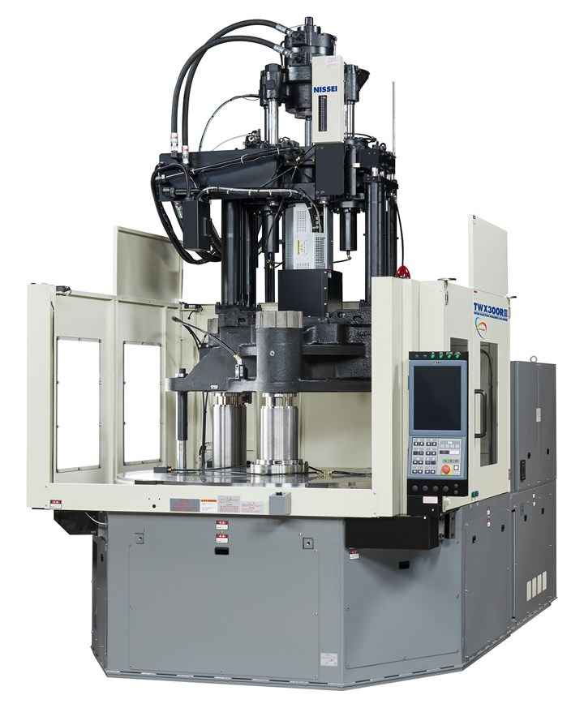
VERTICAL INSERT INJECTION MOULDING MACHINES :
S. No. | Machine Type | Capacity / Specification | Capacity | Make
1 | VERTICAL INSERT INJECTION MOULDING MACHINE | 60 TONNES | 3 | NISSEI
2 | VERTICAL INSERT INJECTION MOULDING MACHINE - ROTARY | 100 TONNES | 1 | HISHIYA-TIE BAR LESS
3 | VERTICAL INSERT INJECTION MOULDING MACHINE - ROTARY | 120 TONNES | 1 | NISSEI

Slide 13
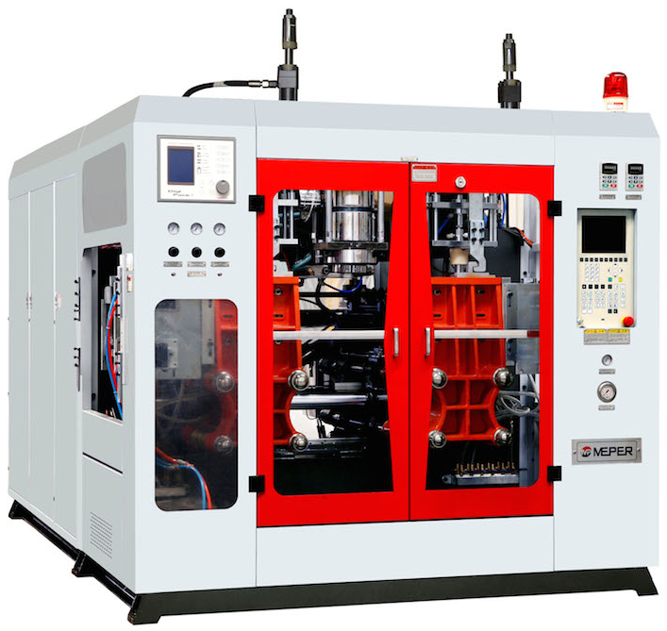
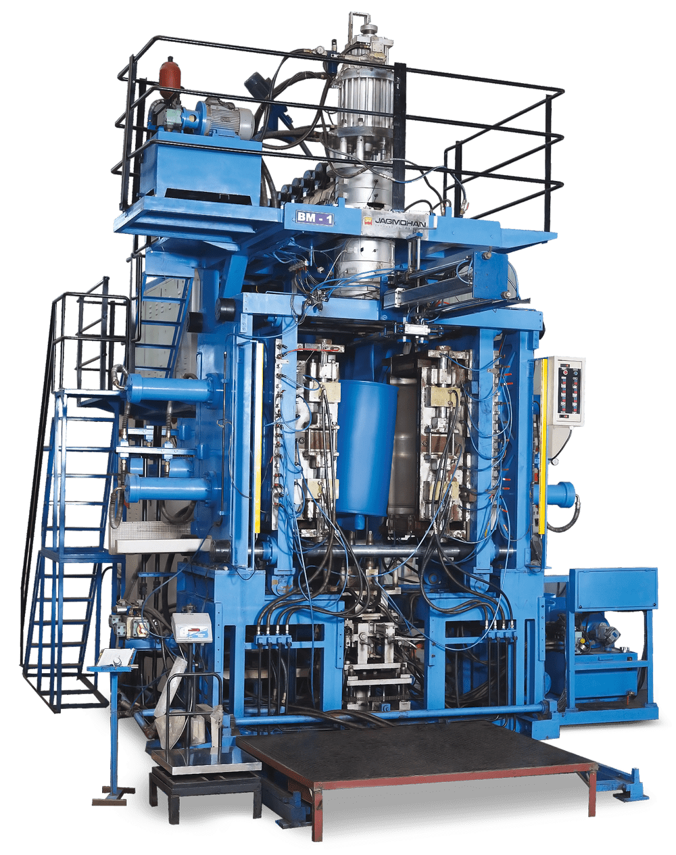
BLOW MOULDING MACHINES :
S. No. | Machine Type | Capacity / Specification | Capacity | Make
1 | FULLY AUTOMATIC BLOW MOULDING M/c | 1 LTR | 1 | JAGMOHAN
2 | FULLY AUTOMATIC BLOW MOULDING M/c | 3 LTR | 2 | JAGMOHAN
3 | FULLY AUTOMATIC BLOW MOULDING DOUBLE STATION M/c | 5 LTR | 2 | JAGMOHAN
4 | FULLY AUTOMATIC BLOW MOULDING M/c | 15 LTR | 1 | JAGMOHAN
5 | FULLY AUTOMATIC BLOW MOULDING M/c | 20 LTR | 1 | JAGMOHAN
6 | FULLY AUTOMATIC BLOW MOULDING M/c | 40 LTR | 1 | JAGMOHAN
7 | FULLY AUTOMATIC BLOW MOULDING M/c | 80 LTR | 1 | JAGMOHAN
8 | FULLY AUTOMATIC BLOW MOULDING M/c | 150 LTR | 2 | JAGMOHAN

Slide 14
RAW MATERIAL PROCESSING CAPABILITIES :
SR.NO | RM Name | RM Grade
1 | ABS | T65XF
2 | AKULON | S223-G6
3 | DELRIN | 900PNC010
4 | DELRIN | F20-J
5 | DELRIN | PM3007GSNT(525 GR)
6 | DURANEX | PBT 30% 531 HS
7 | DURETHEN | BKV 30Q
8 | EVA | N8038
9 | HDPE | B-6401
10 | HDPE | HD50MA 180
11 | HYTREL | 7246
12 | LUCHAR | ARG-10
13 | NYLON | 66BN RN66GF33
14 | NYLON | TORAY(CM3006G50)
15 | NYLON-6 | 73G30L BLACK
16 | NYLON-6 | B30S
17 | NYLON-6 | M28RC
18 | NYLON-66 | NGF66B30%
SR.NO | RM Name | RM Grade
19 | NYLON-66 | OSAMIDE ASG10C
20 | NYLON-66 | RGF33W BLACK
21 | NYLON-66 | ULTRAMID A3WG10 BLACK 00564
22 | NYLON-66 | ULTRAMID A3W2G10 BLACK 20560
23 | NYLON-66 | ULTRAMID A3WG6 BLACK 20560
24 | OSAMIDE | 70G 10 HS BK
25 | PC | 500BK06
26 | PC(N) | 143/1111
27 | PI-LON | 630P
28 | PI-LON | P NAT
29 | POM | N2320
30 | POM | W2320
31 | PP | 110MAS
32 | PP | D120MA
33 | PP | DANA BLACK
34 | PP | DELRIN 100PNC010
35 | PP | DELRIN 500P NC010
36 | PP | DELRIN F-20-03
SR.NO | RM Name | RM Grade
41 | PPCP | B-220MN
42 | PPCP | M-304
43 | PPCP | M312
44 | PPCP | MI-3530
41 | PPCP | B-220MN
42 | PPCP | M-304
43 | PPCP | M312
44 | PPCP | MI-3530
45 | PVC | COMPOUND 50 BK
46 | ZYTEL | 101FNC010
47 | ZYTEL | 101LNC
49 | ZYTEL | 70G30HSLR BK
50 | ZYTEL | 70G30HSLR NC
51 | ZYTEL | 7331 JNC010
52 | ZYTEL | FR50 BK
53 | ZYTEL | MT409ASH NC010

Slide 15
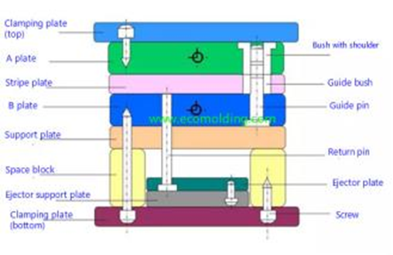
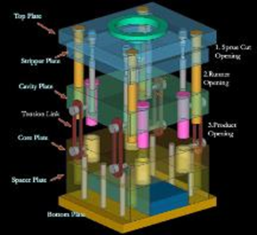
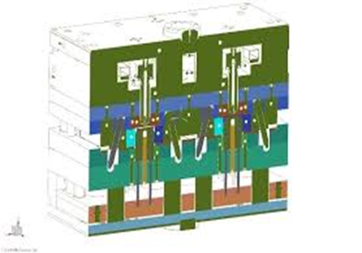
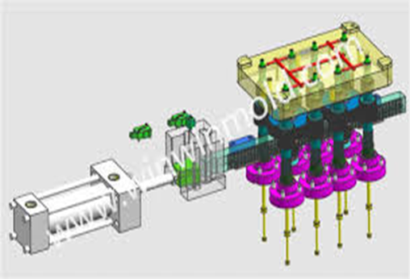
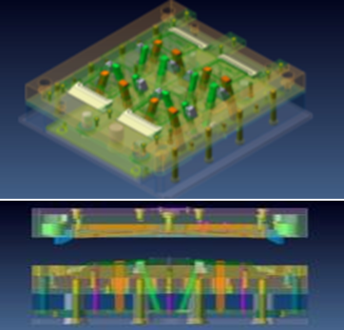
In-House Mould Design and Manufacturing
2-PLATE MOULD
2-PLATE MOULD
HOT RUNNER MOULD
MULTIPLE INSERT MOULDING MOULDS
BLOW MOULDS FROM 1 LITRE TO 200 LITRES
MOULDS SUITABLE FOR PROCESSING HIGH PERFORMANCE MATERIAL LIKE PEEK,PPS ETC.
UNSCREWING MOULD
MOULDS WITH MULTIPLE LIFTERS AND SIDE CORES

Slide 16
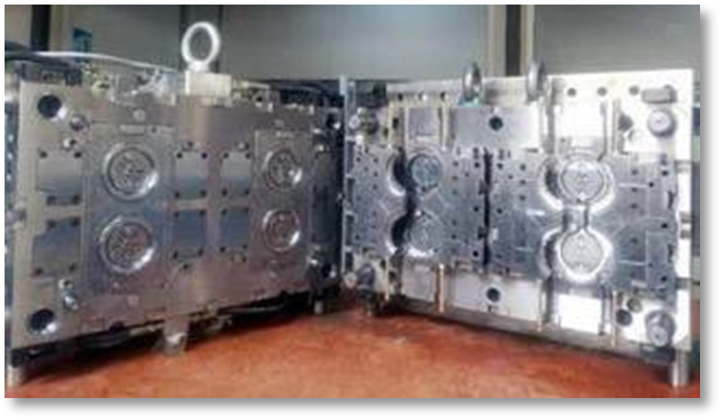
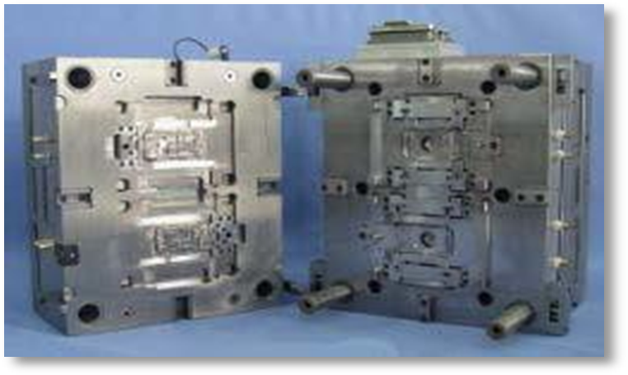
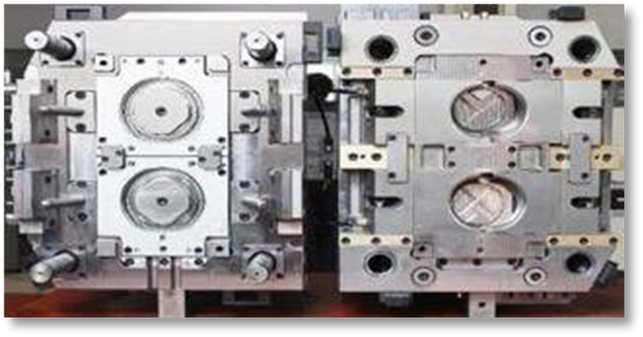
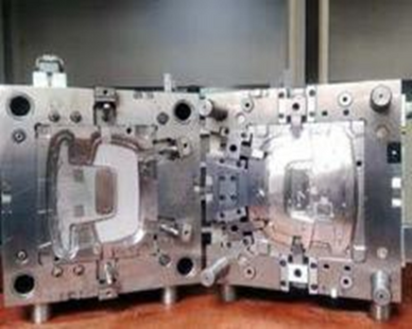
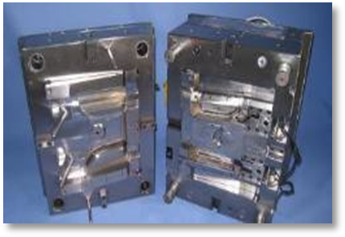
In-House Mould Design and Manufacturing

Slide 17

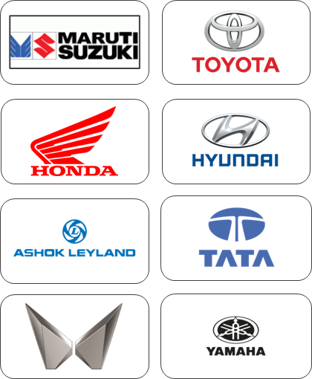
Main Customers
Brands directly served
Brands indirectly served

Slide 18
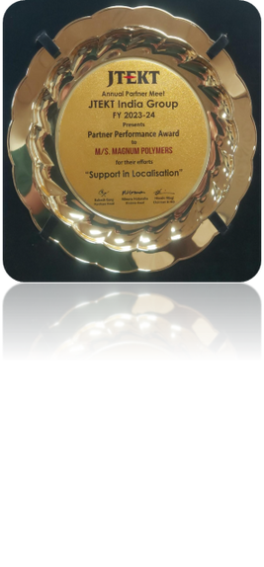
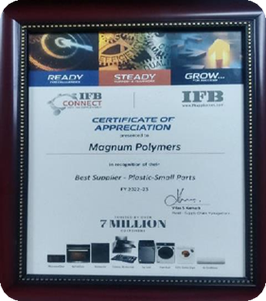





Honors & Awards
Recognition from JTEKT
for Indigenization
2023-24
Recognition from IFB
for Best Supplier
2022-23
Recognition from IFB for Best Supplier In All Aspects
2022-2023
Recognition from JTEKT for Quality
2014
Recognition from JTEKT
for Delivery
2018-19
Recognition from JTEKT
for Delivery
2018-19
Recognition from JTEKT
for Delivery
2018-19

Slide 19





Milestones Achieved
Partner Performance Award received from JTEKT India Group for “Support in Localisation” in FY 2023-24.
2 Nos High Precision 2 Microns Accuracy HASS VMC added in tool room.
ZNC High Precision EDM Machine Added in Tool Room.
MITUTOYO CRYSTA APEX V574 Commissioned in July 2024
Vision Measuring Machine Hexagon make Accuracy 2 Microns Added to achieve more accuracy in part dimension inspection.
100% Supplier Performance Rating for JTEKT for Period Apr’23 – Mar’24.
Land acquired 6 Acres in Palwal, Haryana Near KMP Circle for future expansion.

Slide 20








Connect with us.
inquiry@magnumwonderplast.com
ceo@magnumwonderplast.com
+91-9318493058
+91-9811061756

Slide 21



Global Connect
MEXICO
Mr. Suresh Rajagopalan
sr@magnumwonderplast.com
+1 647 961 1283
CANADA
Rithwik Trehan
rithwiktrehan@magnumwonderplast.com
+1 (647) 649-8826
USA
Mr. Lalit Verma
lalit.verma@magnumplast.com
+1 248 778 6553

